Slide 1
BVRIT HYDERABAD College of Engineering for Women
Data Science Web App
Department of IT
Sai Prasanna Banoth-17WH1A1217
Divya Krupa Begari-17WH1A1220
Deepika Bhupathiraju-17WH1A1221
Guide : Mr. L. Naveen Kumar
Assistant Professor

Slide 2
Problem Statement:
Every year more than 2,00,000 vehicle collisions occur in the five boroughs of New York City.The NYPD began publishing a data set of every recorded vehicle collision in the city . This project aims to analyze the traffic collision data set and present visually identifiable patterns.

Slide 3
Tools used:
Streamlit
Python
Visual studios

Slide 4
About The App:
Building an interactive web application with streamlit and python and we used pandas for data manipulation in data science work flows.
We have used motor collision data set in new York city.
This would enable city planners, traffic management, and commuters to make informed choices and reduce the risk of collisions.

Slide 5
Tasks :
Load the Motor Vehicle Collisions Data
Visualize Data on a Map
Filtering Data and interactive Tables
Plot Filtered Data on a 3D Interactive Map
3D Interactive Map
Charts and Histograms
Select Data Using Dropdowns

Slide 6
Procedure:
This application is a Streamlit Dashboard that can be used to analyze Motor vehicle collisions in the given data set, it analyses where the most people injured in that place and how many collisions occurred during a give time of day and top 5 dangerous streets by affected persons.
We represented the collisions in two different ways according to the time and number of people injured in collision and we even represented the data in bar graph using plotly library.

Slide 7
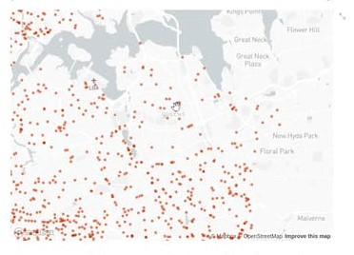
2D Map Plotting:
In 2d plotting we plotted the number of persons injured during the collision and we even added a slider to set the number of persons and range of this slider is 0 to 19. and we are plotting this graphs for 2 lakh rows.

Slide 8
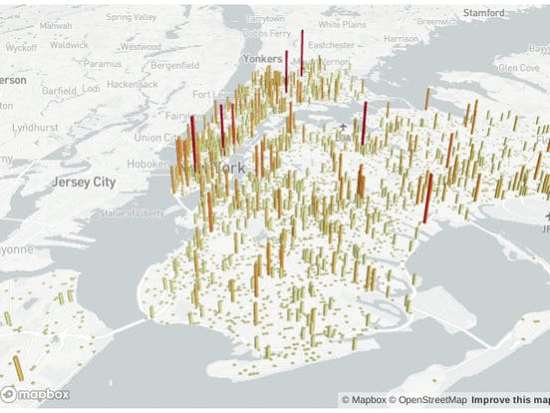
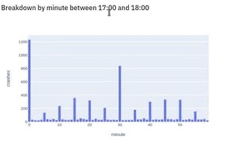
3D Map Plotting:
In this 3d map we can check the number of collision occurred in the particular time using pydeck library and we can set the time using the slider
When we change the time and even the Histogram plotting will also changes according to the time we set.

Slide 9
Skills We Learned :
By the end of this project, we learned how to build beautiful and interactive web app by using Python and Streamlit .
We were able to load , explore, visualize and interact with data and generate a dashboard using python and streamlit.

Slide 10
Final Web Page

Slide 11


